Slide 1
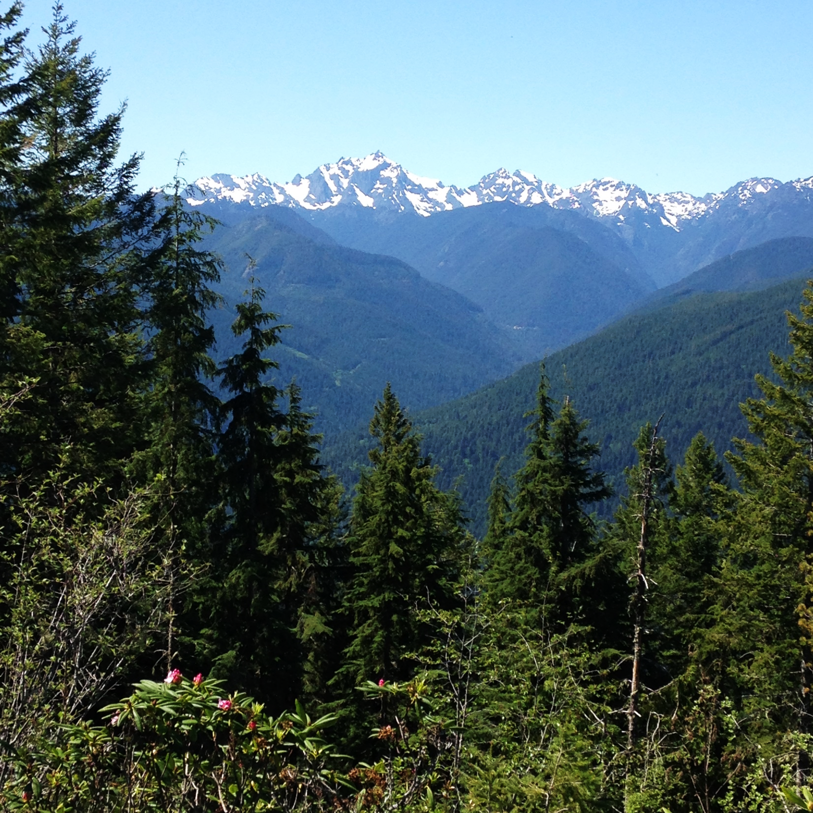

Predicting height growth for the Douglas-fir Seed-Source Movement Trial
Rebecca Sanders-DeMott, Paul Selmants, Rose Abramoff, German Vargas, Janet Prevey
July 26, 2019
Notes:
Here's more info on the project the data are from: https://www.fs.usda.gov/pnw/projects/douglas-fir-seed-source-movement-trial

Slide 2
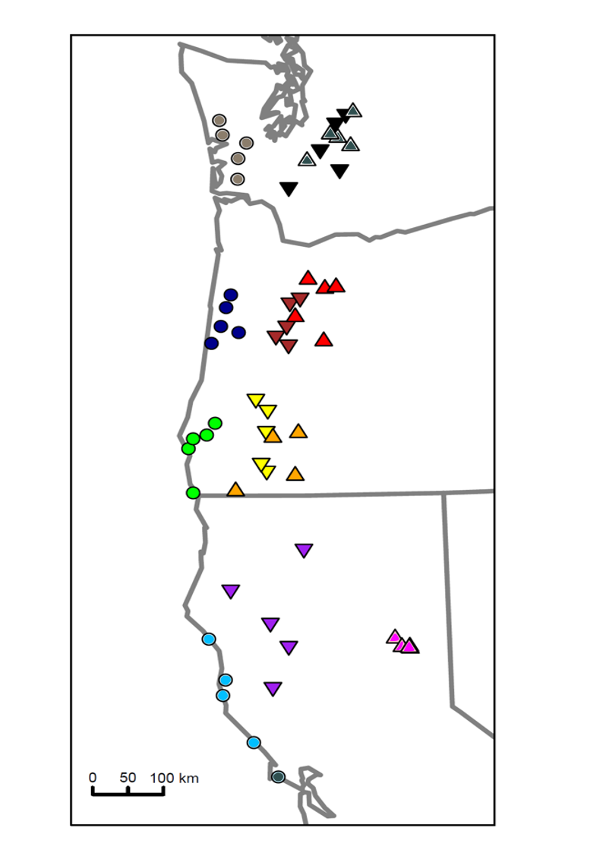
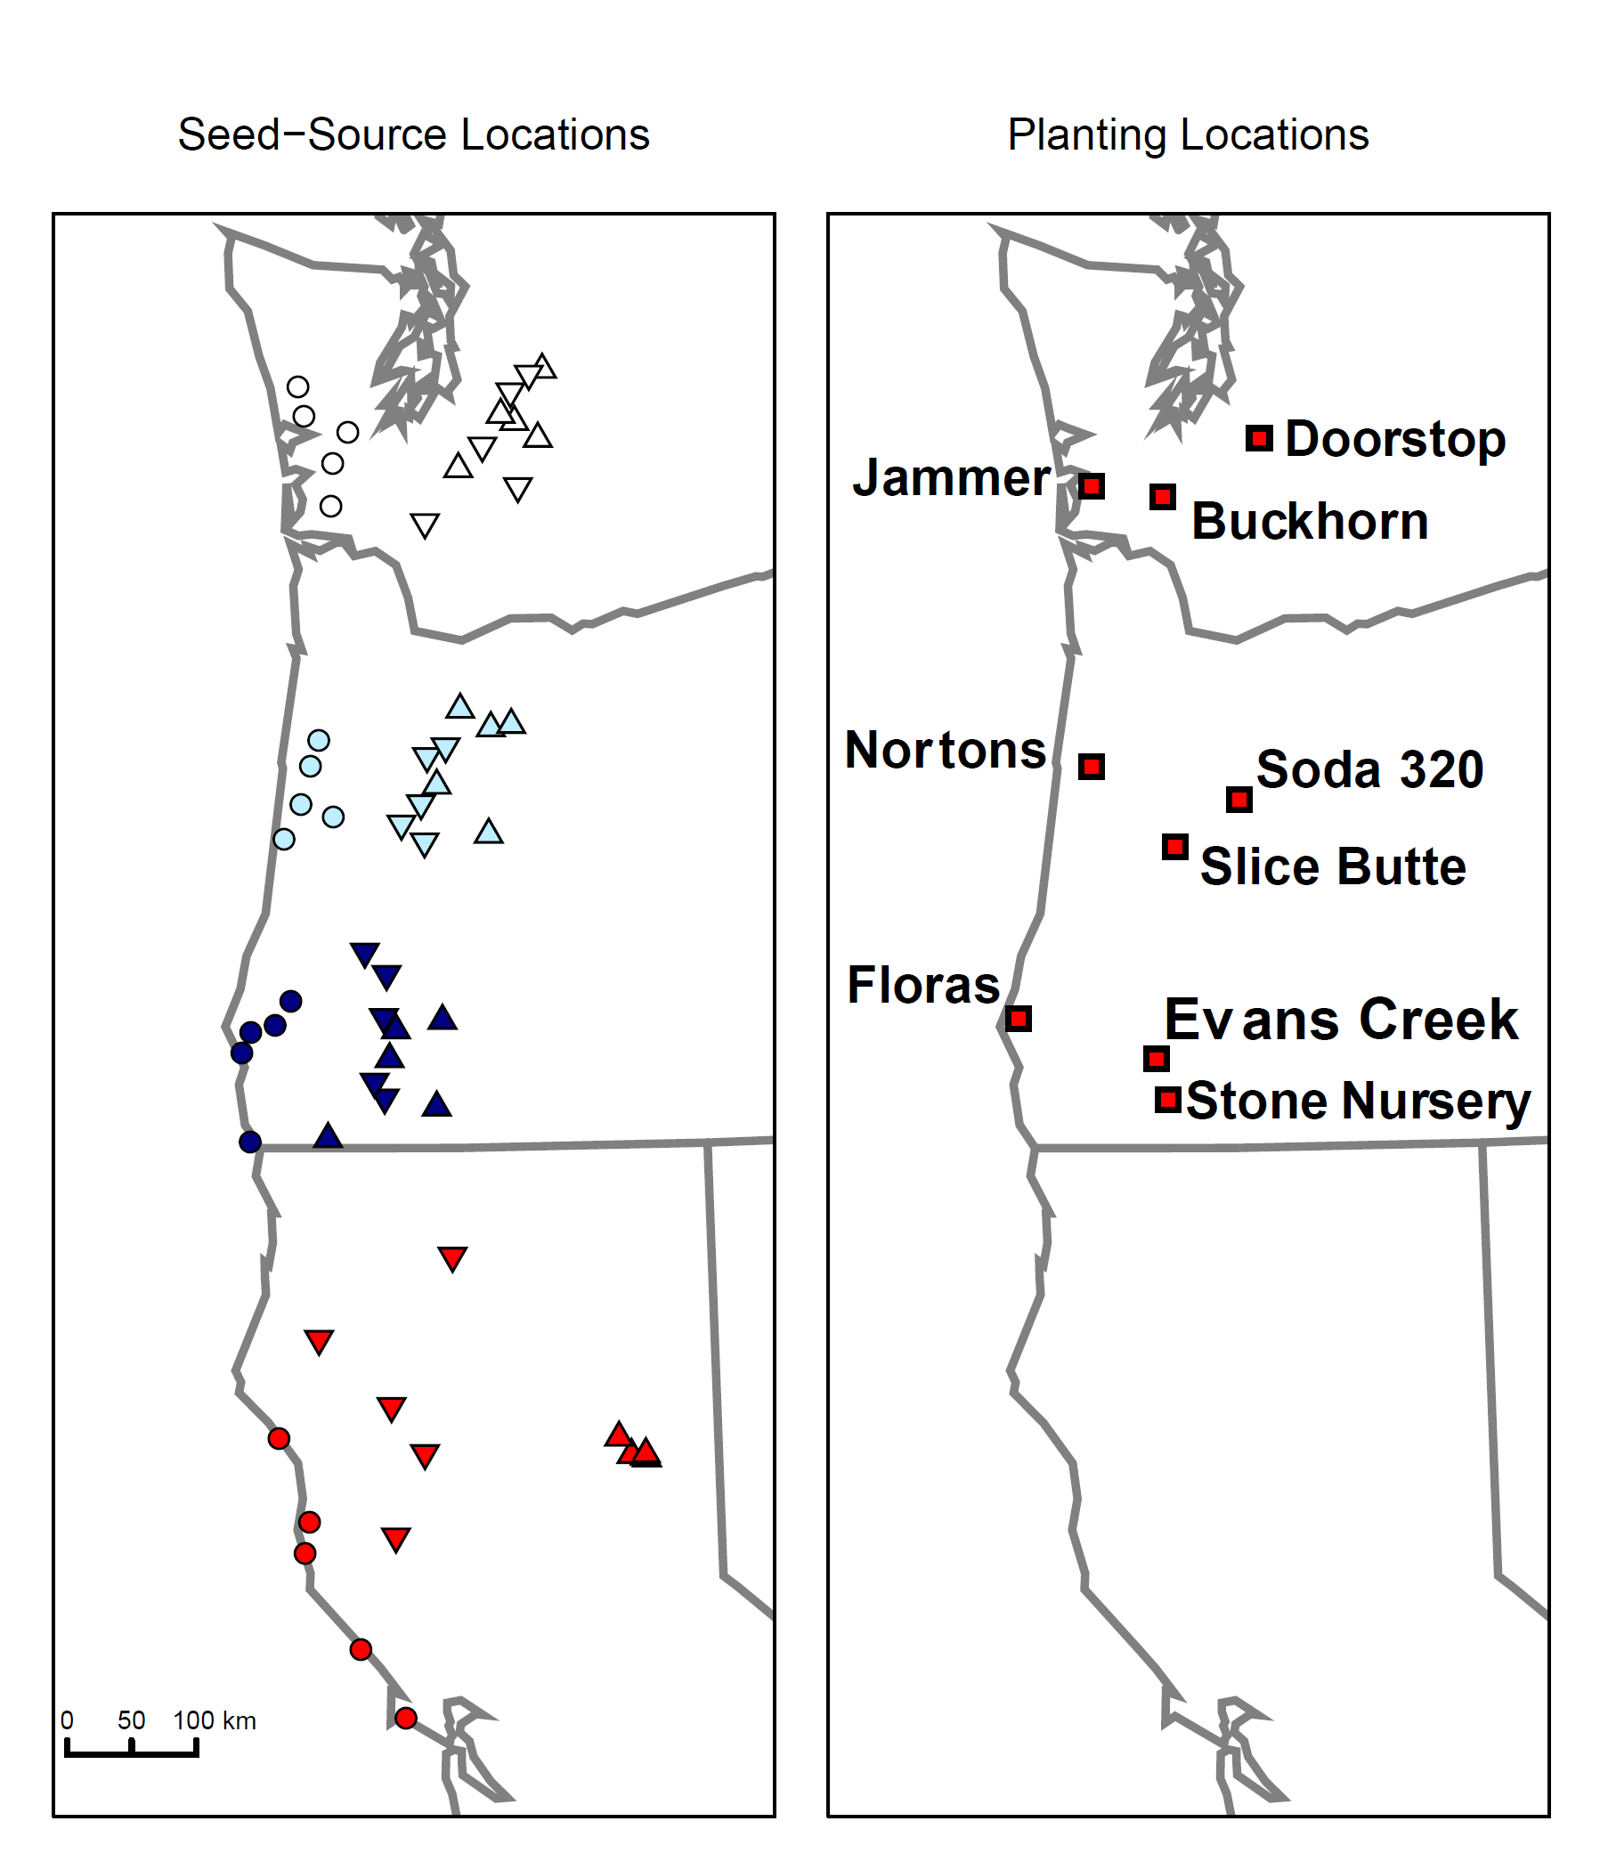
Experimental Design
Seed source
~970 trees from 12 different seed sources, grown for 9 years
Notes:
Colors on map on the left refer to our regions (study used seed from 12 regions). We had 5 locations in a region and 2 trees per location (so 120 families in all). The trees in the field have a large ring to indicate the region and a small ring to indicate the family.

Slide 3
Raw data: Douglas-fir heights over time, by region
Seed source

Slide 4
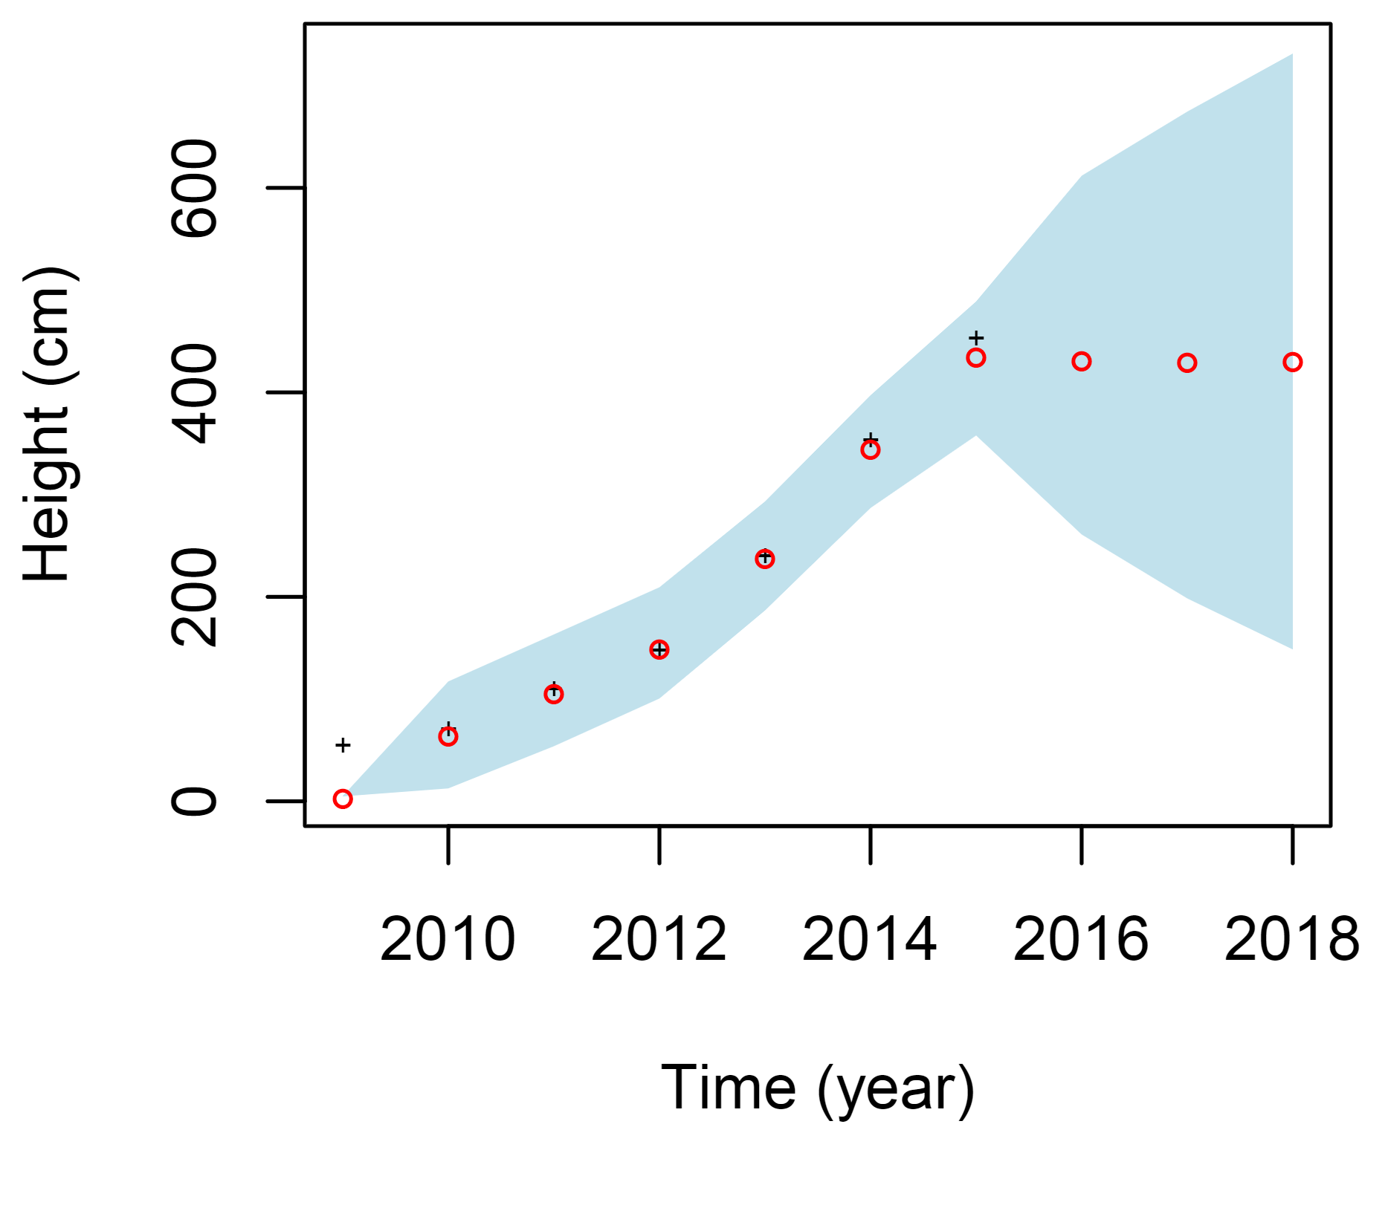
One tree - Uninformative initial conditions (5 cm)

Slide 5
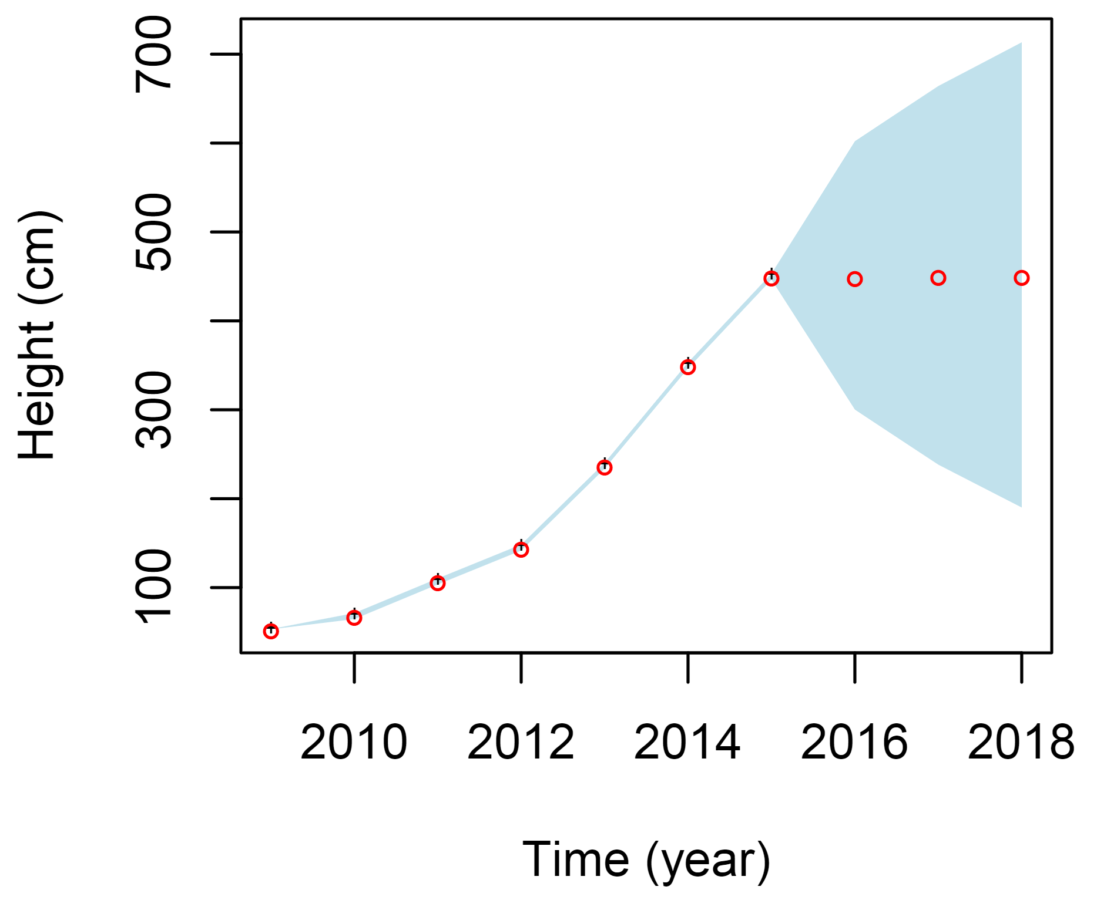
One tree - Initial conditions are actual initial conditions of the data

Slide 6
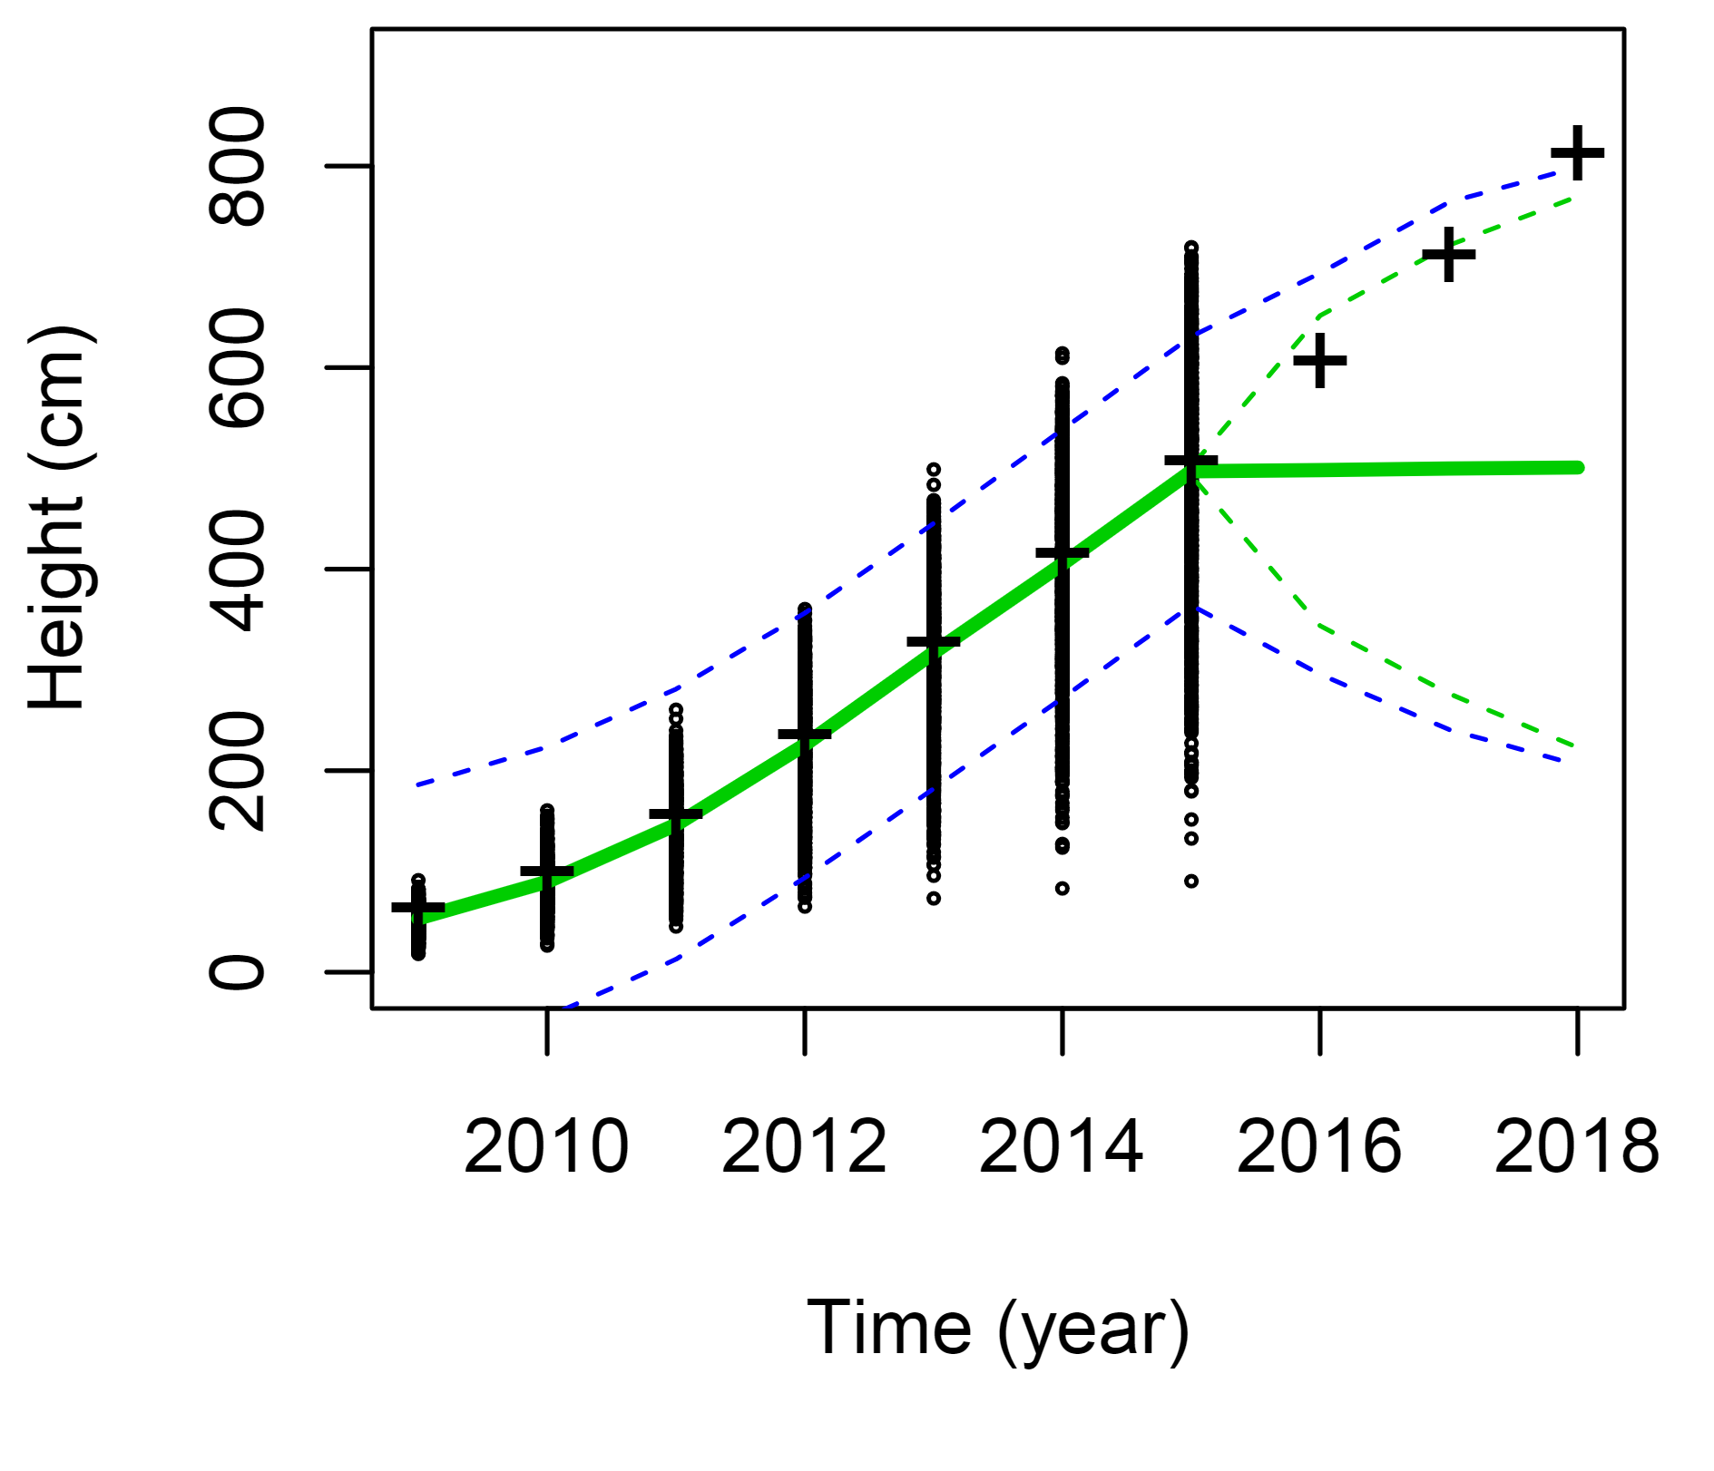
All trees - random walk model

Slide 7
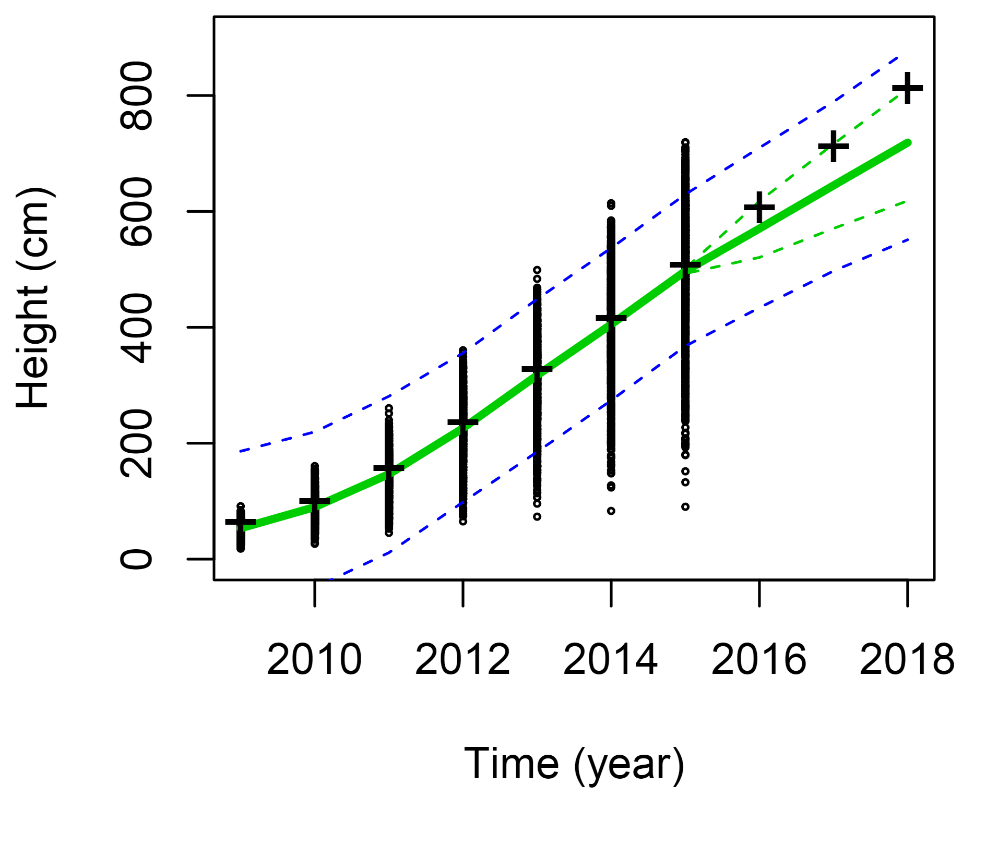
All trees – linear growth model
Notes:
Green are credible intervals, blue are prediction intervals

Slide 8
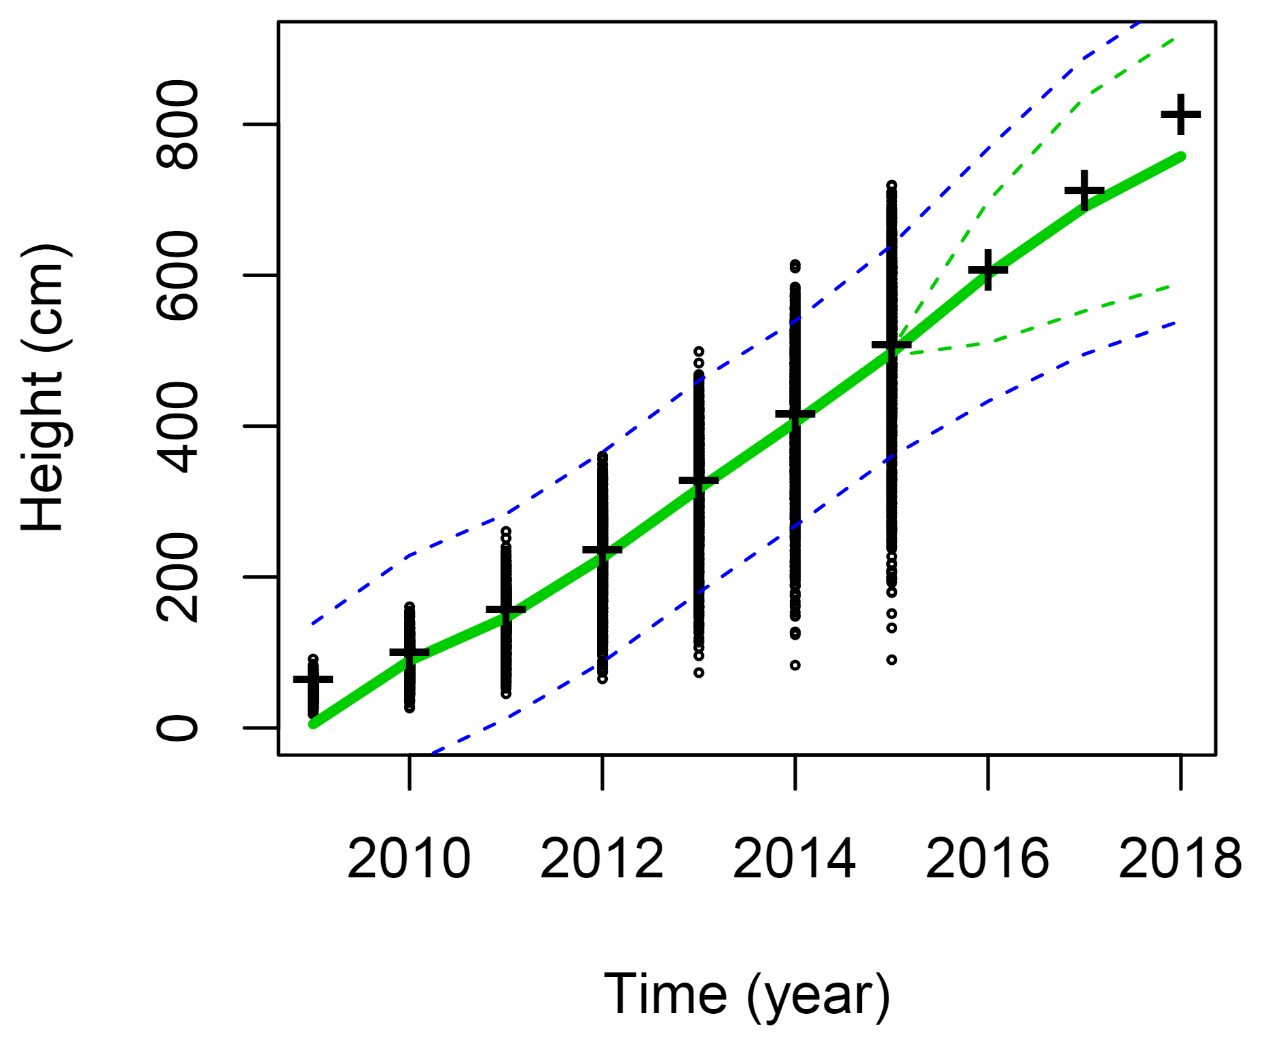
All trees – logistic growth model
Notes:
Model assessment

Slide 9
Some diagnostics….

Slide 10
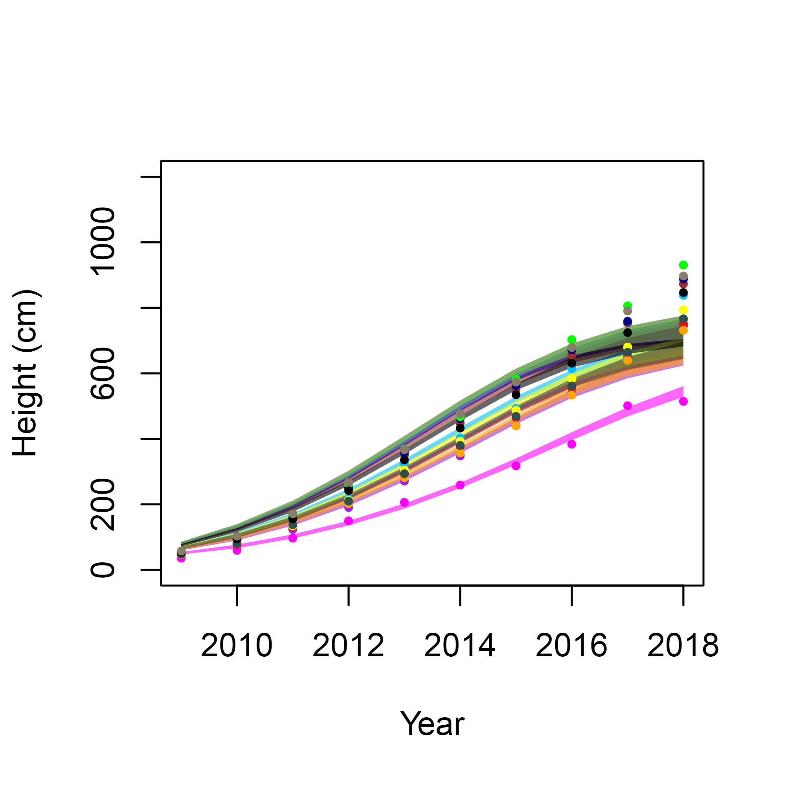
All trees by region – logistic growth model
Seed source

Slide 11
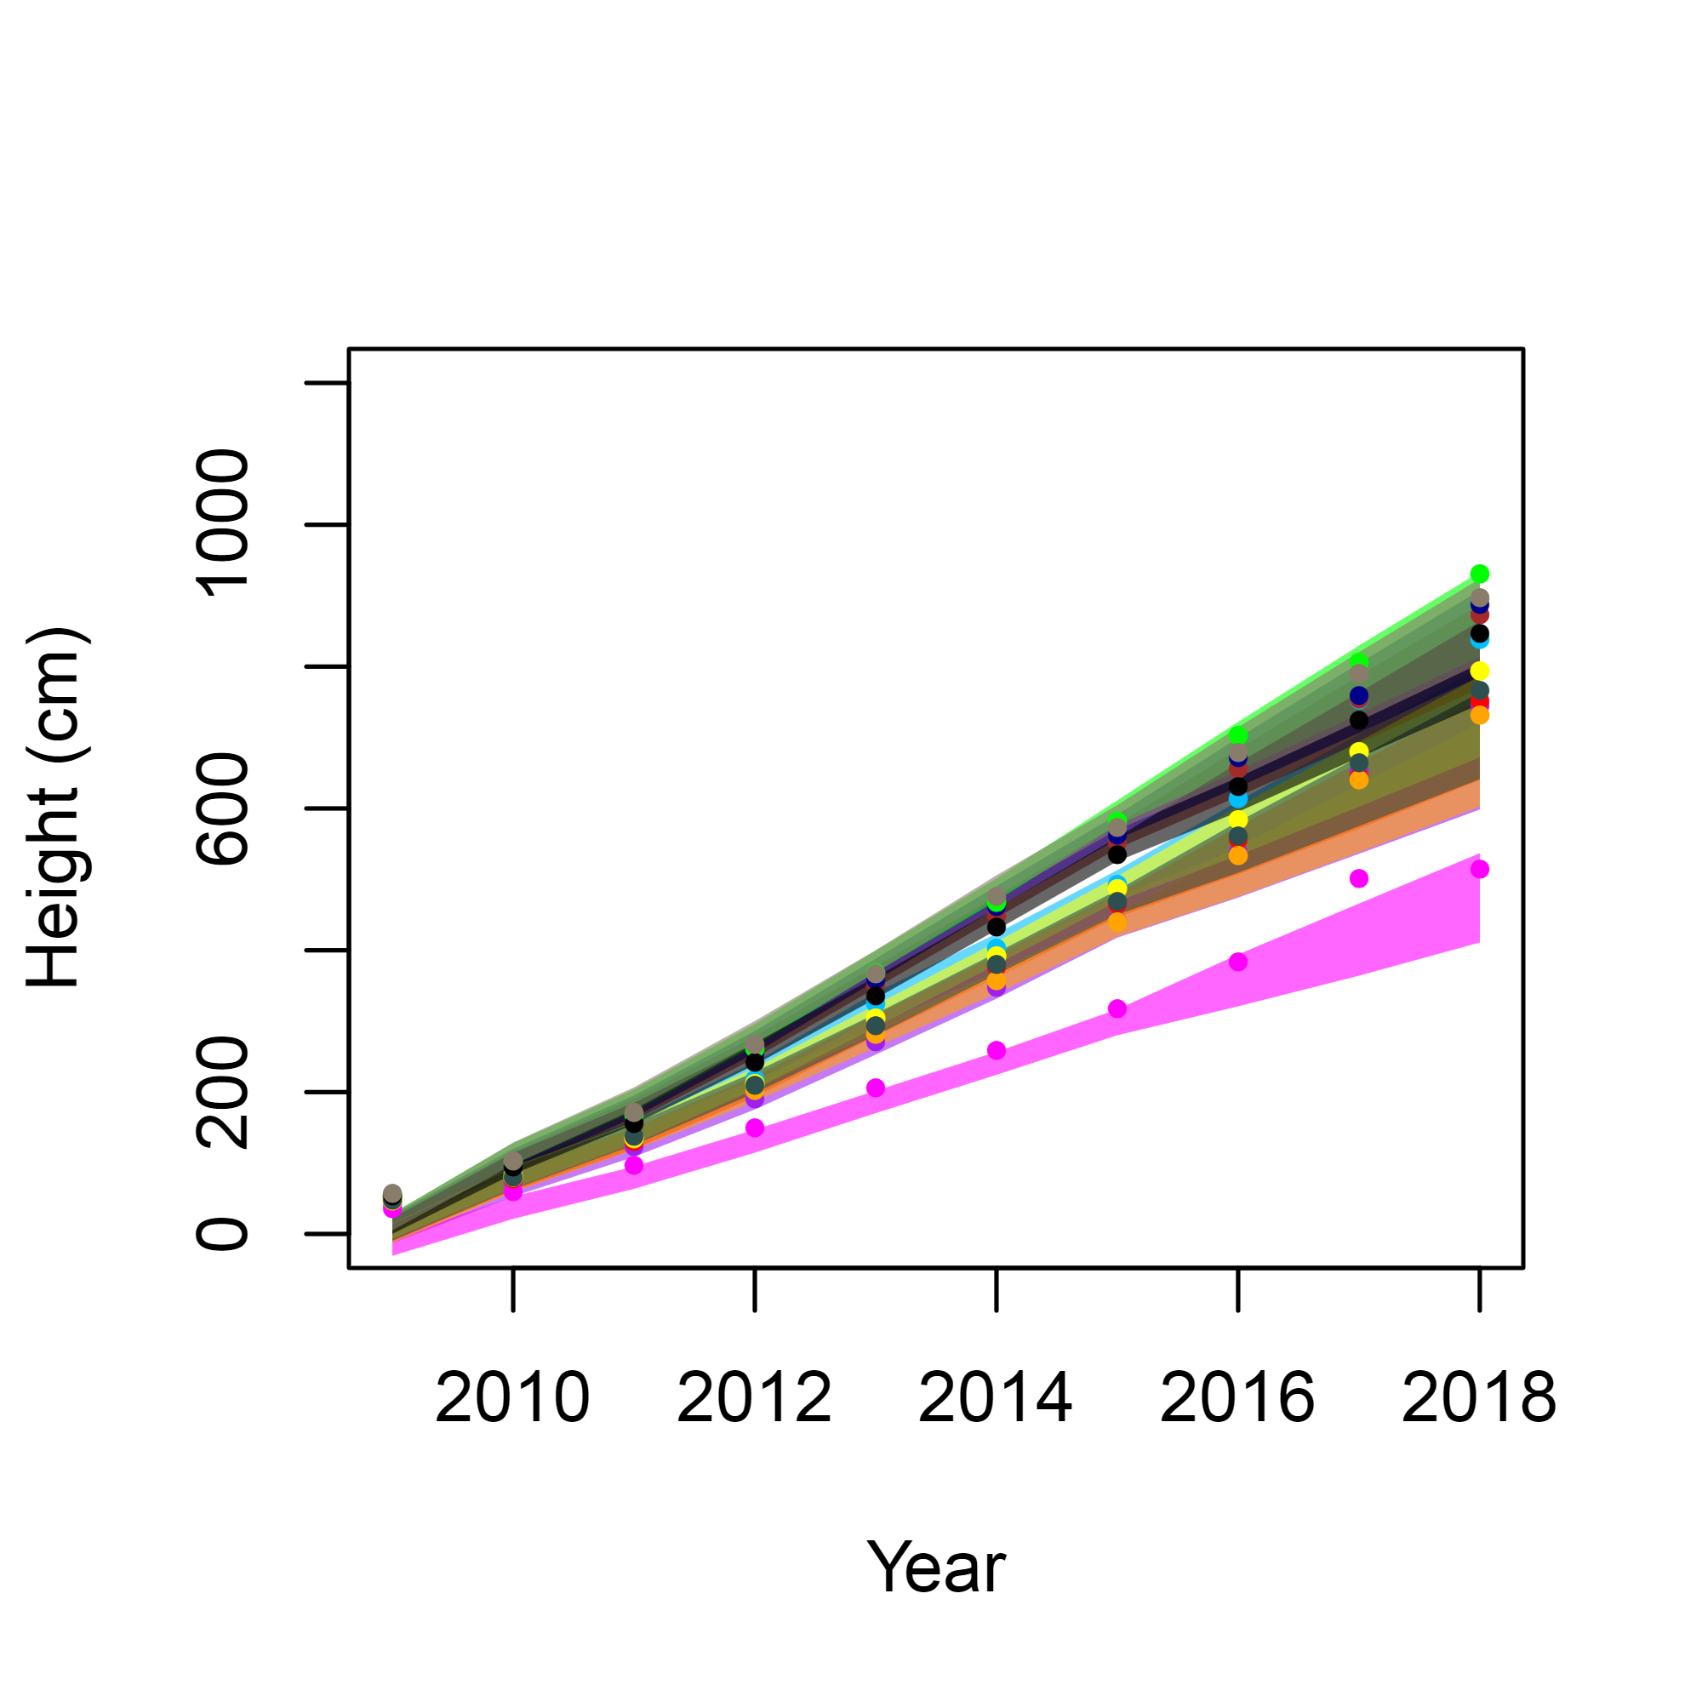
All trees by region – linear growth model
Seed source

Slide 12
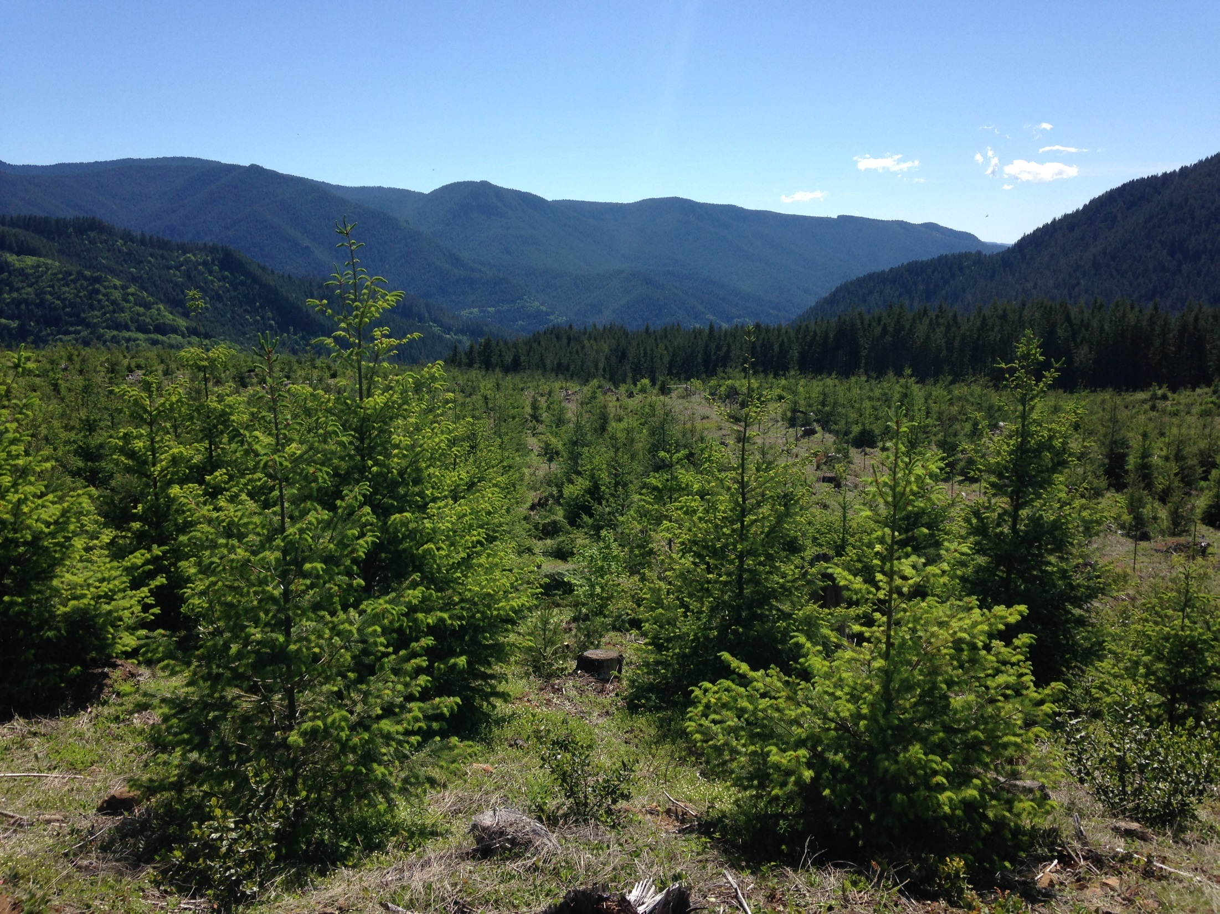
Next steps:
How does mortality vary by seed source? Can we predict it in the future?
Do temperature and precipitation also influence yearly tree growth?
How might temperature and precipitation differentially affect trees from different seed sources?
Do these patterns in tree growth vary across sites with different climates?
Can we scale up predictions from sites to show spatial patterns in young Douglas-fir growth over time?

Slide 14
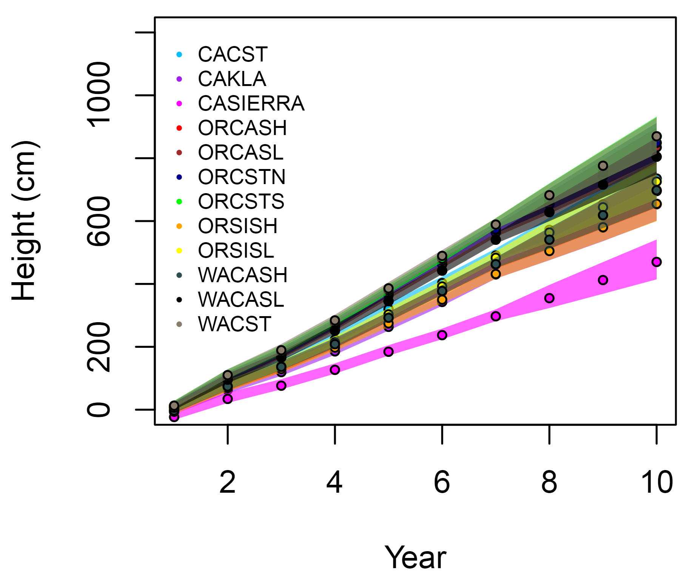
All trees – linear growth model
Notes:
Linear growth model

Slide 15
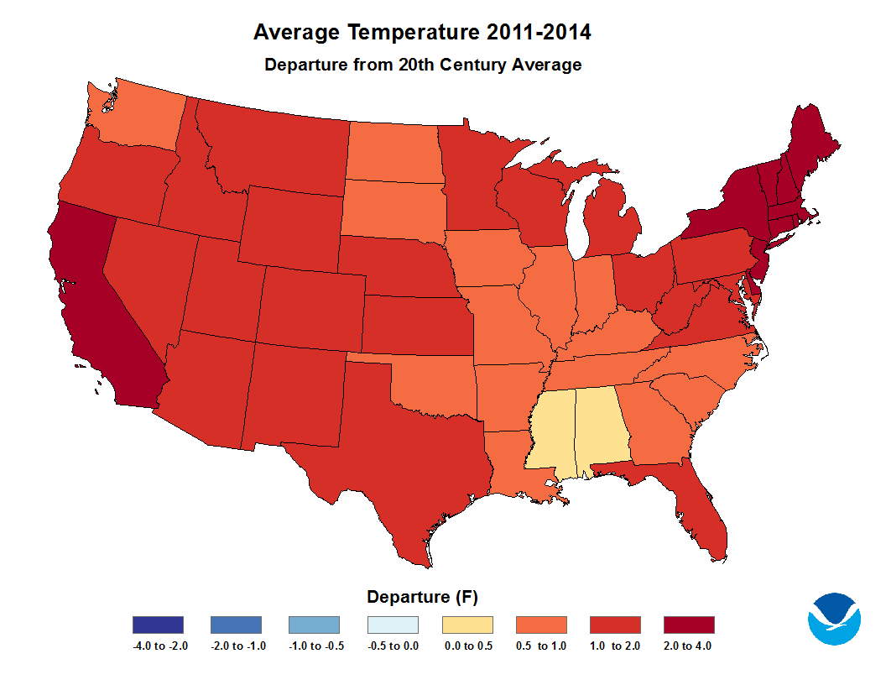
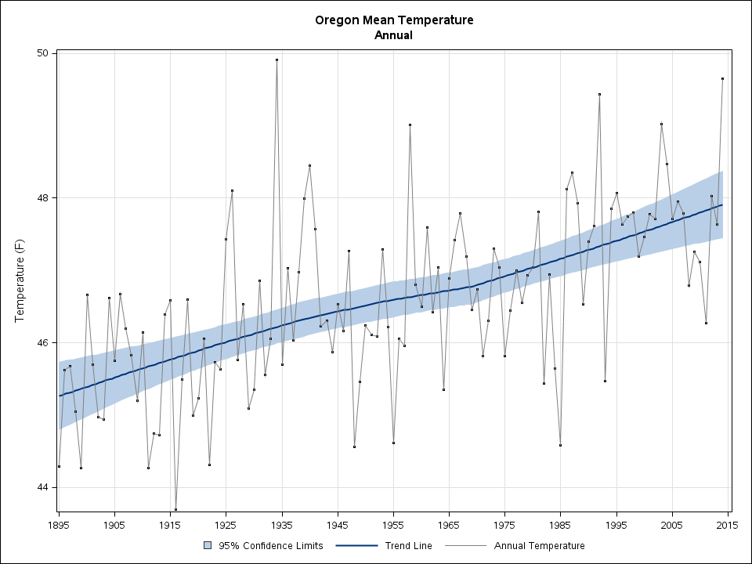
Next Steps
Managers want to accurately predict timber growth and yield over shorter as well as longer timeframes
Understanding the environmental and genetic cues that affect growth will help us predict changes, and manage for more desirable/adaptable trees in the future
Notes:
If the models for M/F are not the same, then there is an opportunity for the processes of pollination and receptivity to get out of synch - this can be managed in SO when doing controlled crosses – but can be an issue if relying on mass pollination in an orchard or in seed production areas or in natural stands Note – we do NOT think this is currently occuring, but would like to collect data to verify and monitor this
Additionally – if there are chilling requirements for flowering that aren’t met – if , and winters get warm enough that these are not met – it is possible that the trend of early flowering in warmer springs may be reversed – and it is important for us to know that ahead of time…. flowering can be delayed with expensive warming…

Slide 16
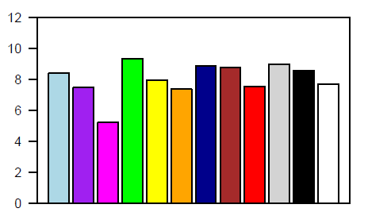
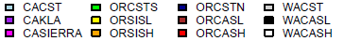
Buckhorn2
10−yr Mean Height (m) − No Ht damages

